Slide 1
Choice Coin: Bitcoin Choices
2022 MIT Bitcoin Expo Hackathon

Slide 2

Team
Samuel Tosin
Kazeem David
Brian Haney

Slide 3
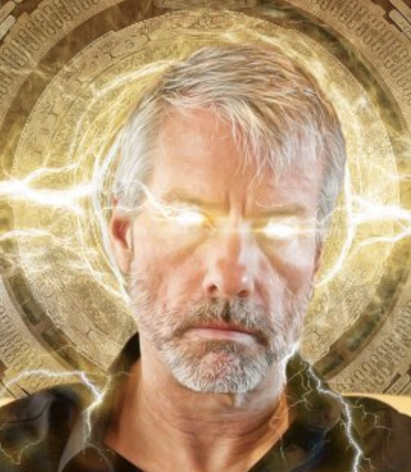
Motivation
Can you come up with a better idea than converting all your $BTC into Dollars before you do anything with it?
Use it
Bitcoin is a key, not an investment

Slide 4
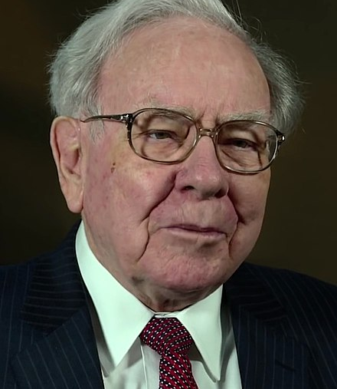
Problem
How do you use Bitcoin?
How can you create value without dollars?
Bitcoin governance problem

Slide 5
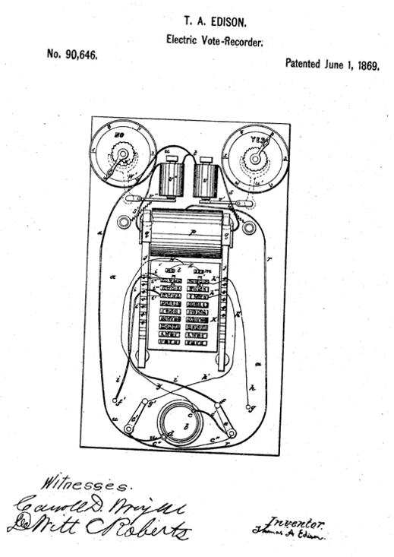
Solution
Bitcoin Choices
Global governance
Voting technology

Slide 6
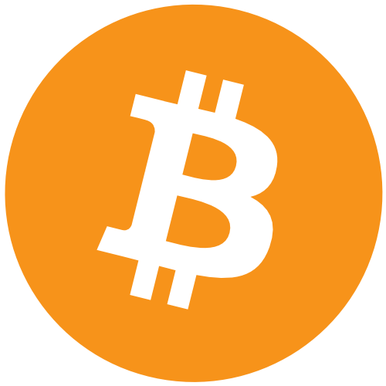
Bitcoin
Satoshi Nakamoto
Probably Hal Finney
Greatest innovation since the microprocessor
Globally decentralized network

Slide 7
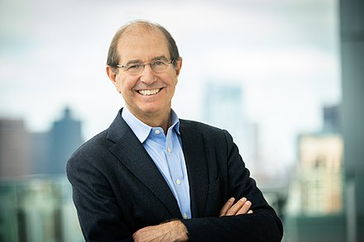
Algorand
Proof-of-stake
Founded by Silvio Micali
Great place for opportunity and entrepreneurship
Great place to build great blockchain technology

Slide 8
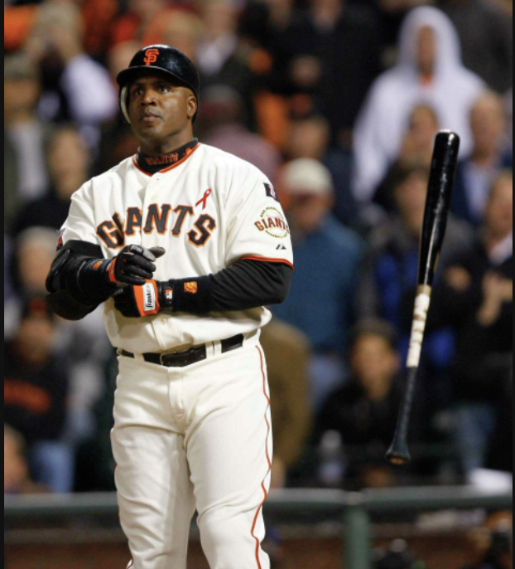
goBTC
AlgoMint
BTC on steroids
Fast, secure, and cheap

Slide 9
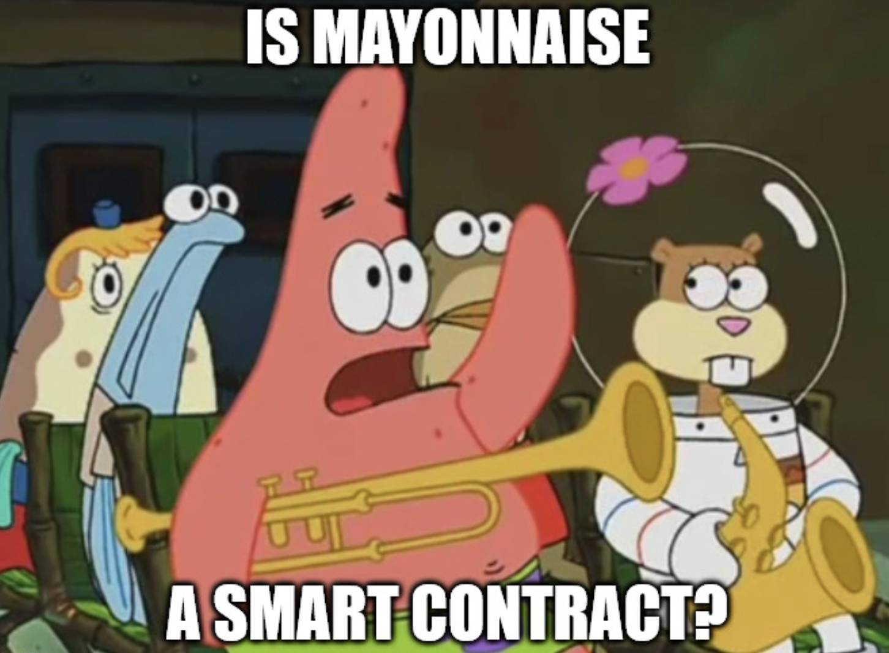
Bitcoin Choices
Bitcoin-choices.com
Bitcoin Voting on Algorand
Post-quantum secure
Global, scalable, fast
On-chain results
Algogeneous smart contracts

Slide 10
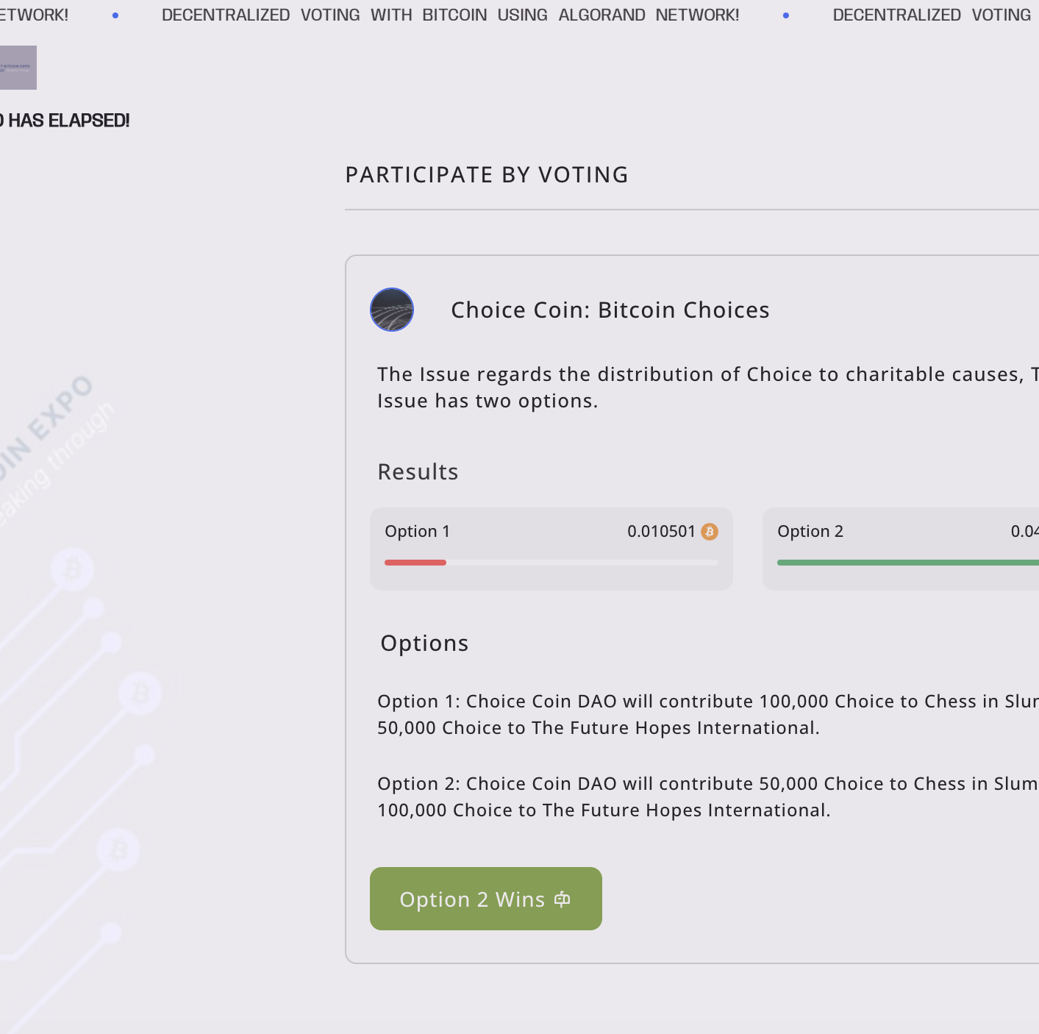
The Vote
Open for about 30 minutes on May 7th
Voters
11
Total BTC commit ~0.0056
Charitable contributions to Chess in Slums and Future Hopes International

Slide 11
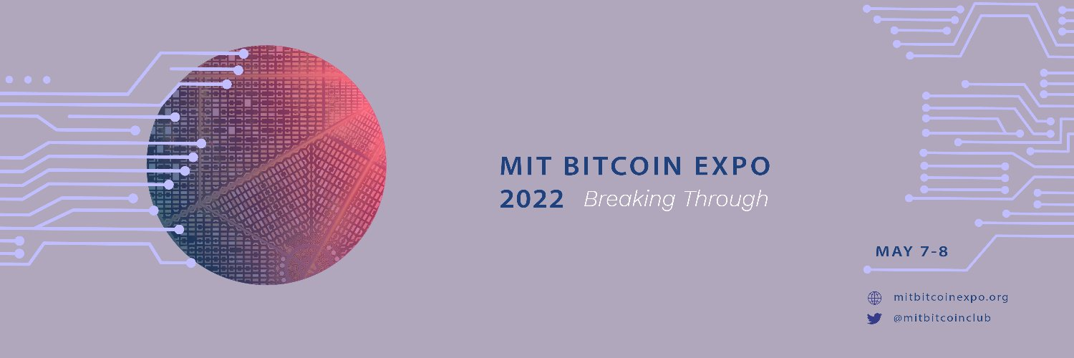
Thank you!

